Slide 1
SIGN LANGUAGE RECOGNITION SYSTEM
MINI PROJECT
Department of MCA, MES College of Engineering , Kuttippuram
SEPTEMBER 2022
PREPARED BY
AMINA SHIBILI (MES22MCA-2007)

Slide 2
GUIDED BY
MR. BALACHANDRAN
ASSISTANT PROFESSOR
MASTER OF COMPUTER APPLICATIONS
MES COLLEGE OF ENGINEERING , KUTTIPPURAM

Slide 3
Introduction
Data flow diagram
Product Backlog
User Story
Project Plan
Sprint
Developing Environment
CONTENTS

Slide 4
INTRODUCTION
It's generally challenging to speak with somebody who has a consultation disability. People with hearing and discourse disabilities can now impart their sentiments and feelings to the remainder of the world through gesture based communication, which has permanently turned into a definitive cure. It works with and improves on the combination interaction among them and others. Nonetheless, essentially it is deficient to create gesture based communication. Sign language recognition is an active research field in Human-Computer Interaction technology.
This project explains a new technique of virtual talking without sensors. Web Camera is used to take the image of different gestures and that will be used as input .. This paper explains two way communications between the deaf, dumb and normal people which means the proposed system is capable of converting the sign language to text.

Slide 5
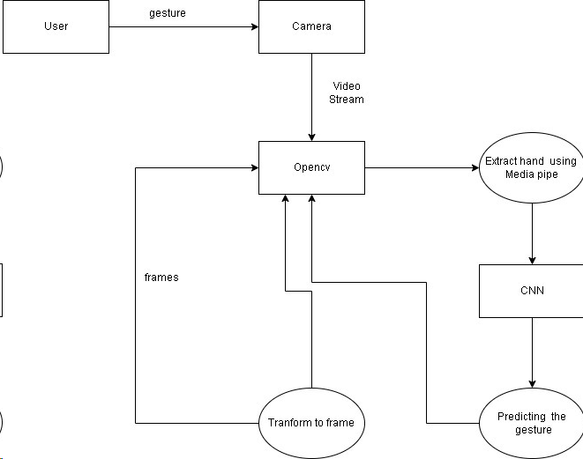
DATA FLOW DIAGRAM

Slide 6
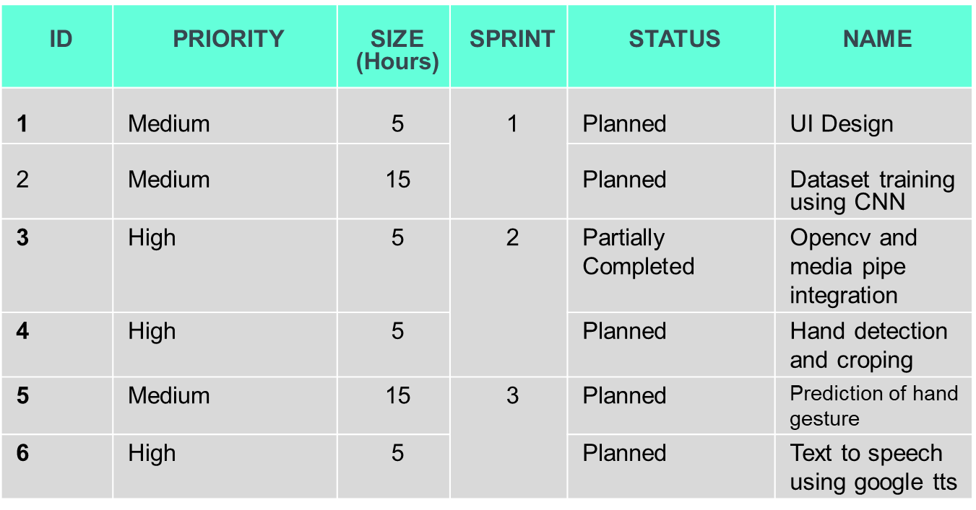
PRODUCT BACKLOG

Slide 7
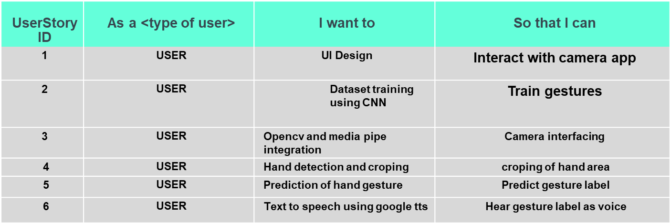
USER STORY

Slide 8
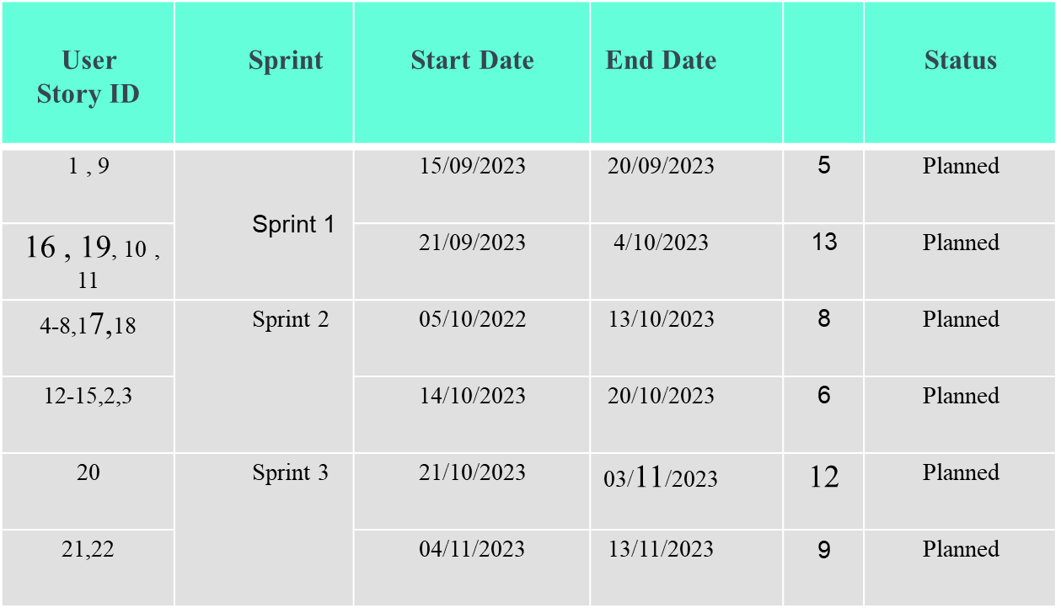
PROJECT PLAN
31

Slide 9
SPRINT PLAN
Backlog Item | Com-pletion Date | Original Estimat-e | Day 1 16/08 | Day 2 17/08 | Day3 18/08 | Day 4 19/08 | Day 5 20/08 | Day 6 21/08 | Day7 22/08 | Day 8 23/08 | Day 9 24/08 | Day10 25/08
User Story # 1 |  | HRS | HRS | HRS | HRS | HRS | HRS | HRS | HRS | HRS | HRS | HRS
Form Design | 16/08 | 1 | 1 | 0 | 0 | 0 | 0 | 0 | 0 | 0 | 0 | 0
Table Design | 18/08 | 1 | 0 | 0 | 1 | 1 | 0 | 0 | 0 | 0 | 0 | 0
Coding | 24/08 | 2 | 0 | 0 | 0 | 0 | 1 | 1 | 1 | 1 | 1 | 0
Testing & validation | 25/08 | 1 | 0 | 0 | 0 | 0 | 0 | 0 | 0 | 0 | 0 | 1

Slide 10
SPRINT PLAN
PROJECT PLAN
Backlog Item | Compl-etion Date | Original Estimate | Day 1 26/08 | Day 2 27/08 | Day 3 28/08 | Day 4 29/08 | Day 5 30/08 | Day 6 31/08 | Day 7 01/09 | Day 8 02/09 | Day 9 03/09 | Day 10 04/09
User Story # 2 |  | HRS | HRS | HRS | HRS | HRS | HRS | HRS | HRS | HRS | HRS | HRS
Form Design | 27/08 | 1 | 0 | 1 | 0 | 0 | 0 | 0 | 0 | 0 | 0 | 0
Table Design | 29/08 | 1 | 0 | 0 | 1 | 0 | 0 | 0 | 0 | 0 | 0 | 0
Coding | 03/09 | 4 | 0 | 0 | 0 | 2 | 2 | 1 | 1 | 0 | 2 | 0
Testing & validation | 04/09 | 1 | 0 | 0 | 0 | 0 | 0 | 0 | 0 | 0 | 0 | 1
Total |  | 20 | 1 | 1 | 2 | 3 | 3 | 2 | 2 | 1 | 3 | 2

Slide 11
DEVELOPMENT ENVIRONMENT
SOFTWARE SPECIFICATION
Operating System
Frond End
Coding language
Backend
: Windows 7 or above
: OpenCV
:Python
:TensorFlow
HARDWARE SPECIFICATION
Processor
Hard Disk
RAM
: Intel Pentium IV or above
:80GB
:6GB or Above

